Slide 1
PCR (Process Change Request )
Definition: Changes of Process refers to the change of equipment, machines, measuring methods and/or materials used in a manufacturing process.
Purpose: The Process Change Report (PCR) is used by the supplier to inform and receive approval from M&C of any change in the manufacturing process and/or materials.
Scope: The procedure applies to all parts and/or materials supplied to M&C and it mandatory in the following cases:
1.- Change of Manufacturing equipment (New/Refurbished/Different).
2.- Change of Manufacturing process (Process Sequence and/or Conditions)
3.- Change of Materials (Supplier of/new/different).
4.- Change of Chemicals used in the Manufacturing Process (i.e. etching, cleansing, heat treating, planting, etc.), that may affect the quality of the parts being produced.
5.- Modification/Refurbishment/Repair(Major) of dies which may affect the quality of the parts being produced.
6.- Change of Modification of Measuring Jigs and/or Inspection tools.
7.- Replacement of Dies (Casting/Molding/Stamping/Blanking).
8.- Change of Delivery Inspection Method or any other inspection method.
9.- When the supplier In-House productions is Subcontracted or Vice versa.
10.- Change of Process/Equipment/Material at Subcontractor ( Same Requirement as 1-9)
11.- Any changes that M&C judges a Process Change Report is necessary.
In the event the supplier is unsure about whether or not the change requires a Process Change Report, they should consult the appropriate Supplier Quality Section of M&Cfor direction.
R&D.02.00.08

Slide 2
R&D.02.00.08
Procedure:
1.- Supplier must submit the Process Change Report to M&C Purchasing and QC as soon as it’s clear a Process Change Report
will occur and an implementation schedule has been established. A three month lead time is preferable due to potential testing requirement
2.- Supplier must, without fail, include Part Number, Part Description, Reason for change, Description of change and
implementation plan.
Additional Supporting documentation must accompany the Process Change Report as described below:
New Process Flow Diagram (if applicable)
Supporting Data (Material Test reports, Quality Improvements, etc.)
Detailed Description of change (if form is not adequate)
Detailed Implementation Plan (if form is not adequate)
Equipment Layout (if applicable)
PFMEA(if applicable)
Any other Documentation the Supplier and/or M&C deem necessary
.
3.- The Process Change Report should be submitted to the appropriate plants
4.- M&C will review the PCR and will judge the acceptability of the change.
If the Process Change is acceptable to M&C, the PCR will be returned to the Supplier with the Reply Section filled out. If the Process Change is unacceptable, the supplier will be notified.
The Reply Section will outline the require submittal and due dates. A Process Audit may also be required prior to approval of the Process Change.
To avoid delays the supplier must submit all documents by the due date
5.- After all submittal are received, The PCR will be routed for the necessary approvals, Supplier will be informed as soon as final approval or rejection has been received.
After approval, Supplier must attached stratification sheet for the first shipment of Process Changed Parts or Material

Slide 3
Form

Slide 4
Example

Slide 5
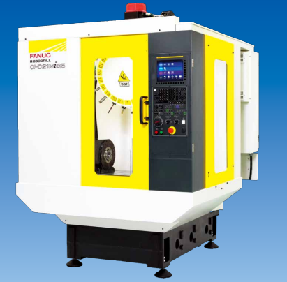
Example
Valve VN150151-0220
PCR: add need machine
Reason: Customer’s order increase from 50k/month to 100k month => we need add 1 machine for machining process
Processs flow
Change
Material
Machining
Cleaning
Inspection
Packing
Current machine | New machine | Evaluation point
FANUC D21M | FANUC D21M Same spec | +FAI ( full dimension ) + Compare CPK between current machine & new machine
Follow Evaluation items to ensure quality of new machine

Slide 6
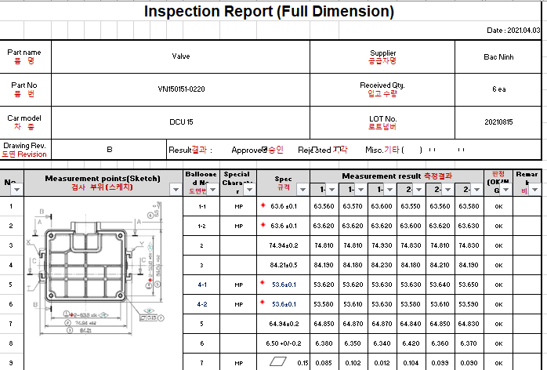
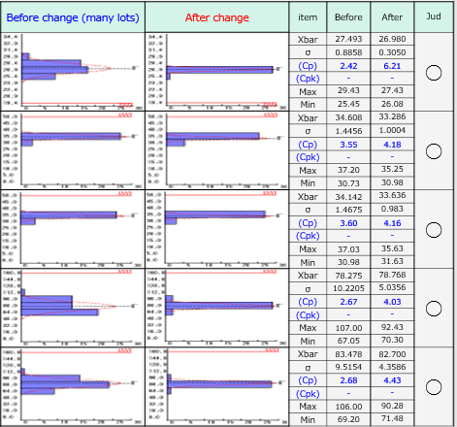
Evaluation result
+FAI ( full dimension )
+ Compare CPK between current machine & new machine
New machine have same result with current machine

